Slide 2
Azure Automation Continuous Integration Framework

Slide 3
Session Abstract
Continuous Integration with Azure Automation or SMA, trough the use of an automation framework “SCOrchDev CI” to provide a highly optimized development experience working on automation solutions.
This Presentation will focus on implementing the framework. Follow up procedures should include the integration of ‘The Release Pipeline’ to the framework

Slide 4

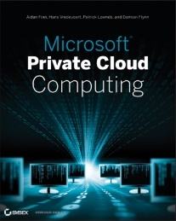
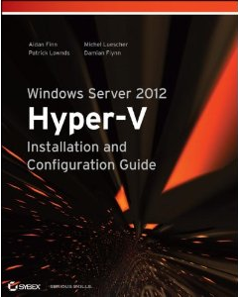
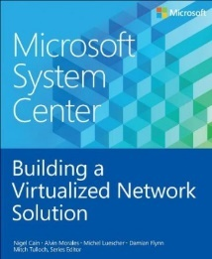

Damian Flynn
MVP System Center
www.DamianFlynn.com
@damian_flynn

Slide 5

Agenda
DevOps and Azure Automation
SCOrchDev CI Framework
Implementation

Slide 6

DevOps with Azure Automation

Slide 7

Release Pipeline
GIT Flow
Life cycle
Environments

Slide 8

Azure Automation Artefacts
Azure Subscription
Automation Account
Log Analytics' Account (aka OMS)
Git Repository
SCOrchDev CI Framework

Slide 9

GIT Flow
Repositories
Forks
Branches
Commit
Push
Fetch
Merge
Pull

Slide 10
GIT Flow Overview
http://nvie.com/posts/a-successful-git-branching-model/
Feature n+1
Feature n
Development
Pre-Release
Master

Slide 11
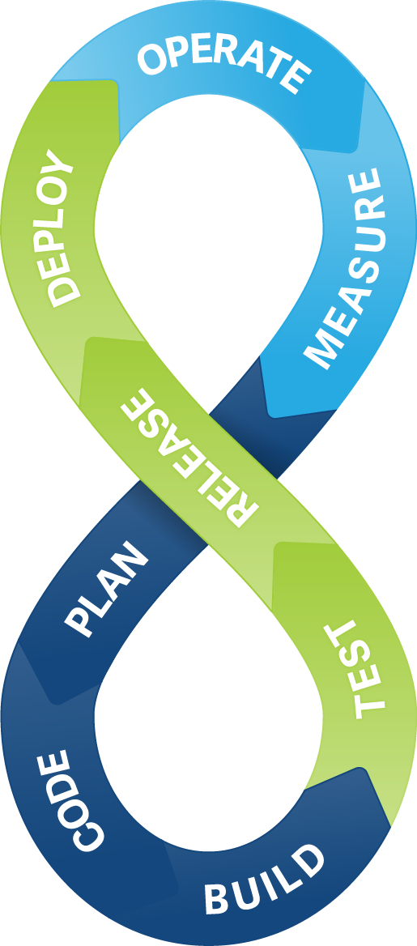

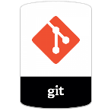
Continuous
Integration
Monitoring Runbook Looping on Custom Schedule
Checks Specified Branch for Changes
Pull Changes to Working Folder
Import Runbooks and Modules into SMA
Development | Validation | Production
Develop | Release | Master
Branches per Feature | Deployment Milestones | Tagged

Slide 12

Framework

Slide 13
Framework
Brainchild of Ryan Andorfer (Microsoft) @Randorfer
Collection of integrated resources
Single centralized configuration file
Local development experience
Live debugging

Slide 14
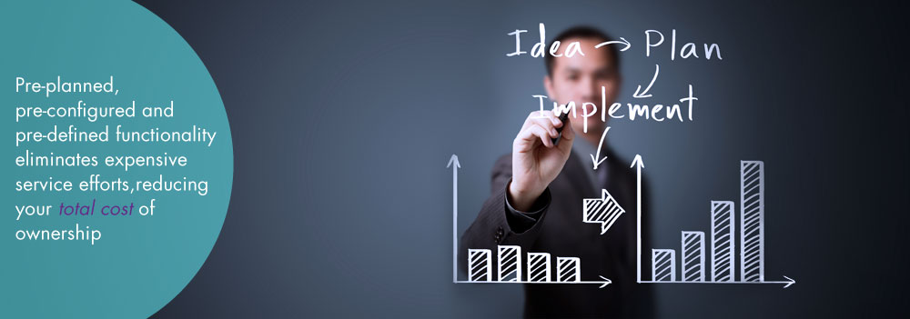
Implementation

Slide 15
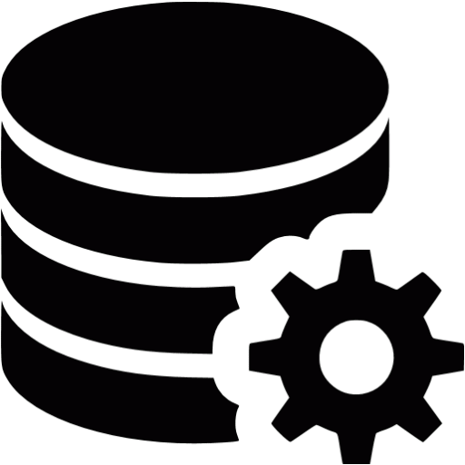
Configuration
Azure Subscription
Log Analytics (OMS)
Credentials
Hybrid Workers
Subscription Admin
Log Analytics Key
“SCOrchDev” Framework

Slide 16
Configuration Artefacts
PowerShell
Workflow
Scripts
Modules
DSC
Variables

Slide 17
Automation Account
Install Local Git Client
HTTPS://git-for-windows.github.io/
Fork / Clone the SCOrchDev CI Repository
Customise the Configuration File
Store Credentials in Local Password Vault
Leverage ARM to Deploy the CI Framework

Slide 18
Demo Implementation

Slide 19
Deployment Progress
Imported all Artefacts
Modules
Script
DSC
Compiled our Desired State Definition
Imported Runbook to Sync all Repo Changes

Slide 20
Demo Automation Account

Slide 21

Workers

Slide 22
Runbook Workers
Workers
On Premise
Or In Azure / AWS
PowerShell 5.0 and newer

Slide 23
Demo Worker Configuration

Slide 24
Runbook Workers
Configuration
Attach the Desired State Definition
Add DSC Extension to the Virtual Machine
Wait for initial Synchronisations to complete
Configuration Overview

Slide 25
GIT Triggers
Configuration of Webhooks
Trigger Runbook Invoke-GITRepoSync
Configure on GitHub.com

Slide 26
Questions

